Slide 1
Adding Tables to Slides
Microsoft Powerpoint 2013
Lesson 5

Slide 2
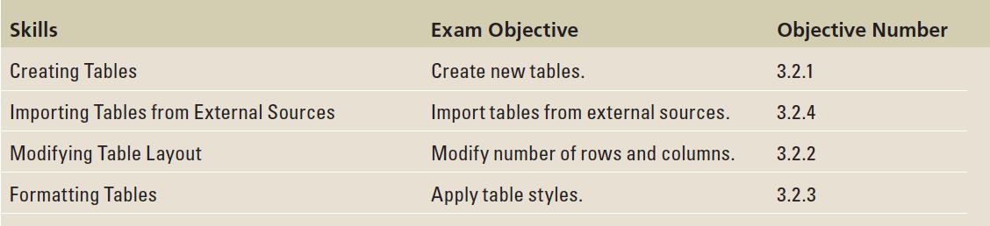
Objectives

Slide 3
Step by Step: Insert a Table
GET READY. Before you begin these steps, make sure that your computer is on. Log on, if necessary.
START PowerPoint, if the program is not already running.
Locate and open the ATMs presentation and save it as ATMs Final.
Click below slide 4 in the left pane and press Enter to insert a new slide with the Title and Content layout after slide 4.
On the new slide, click in the title placeholder and type the slide title, Proposed ATM Locations.

Slide 4

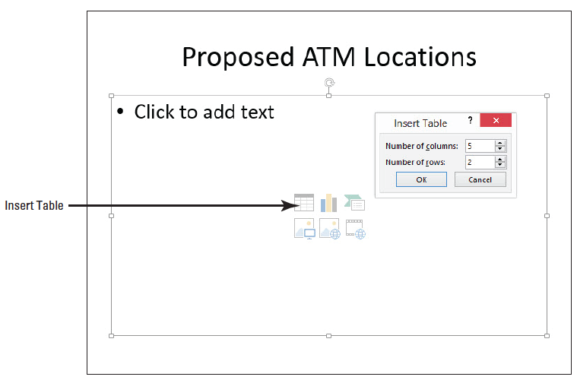
Step by Step: Insert a Table
Click the Insert Table icon in the content placeholder. The Insert Table dialog box opens (below).

Slide 5
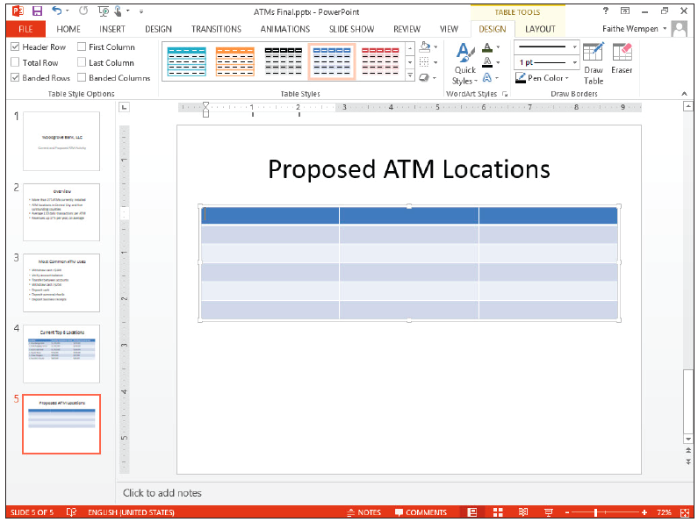
Step by Step: Insert a Table
In the Number of Columns text box, type 3 to specify three columns, press Tab to move to the Number of Rows text box, and then type 6 to specify six rows. Click OK. PowerPoint creates the table in the content area (right). Notice that formats specified by the current theme have already been applied to the table.

Slide 6
Step by Step: Insert a Table
Click in the first table cell in the top row and type Location. Press Tab to move to the next cell and type Site Study Complete. Press Tab to move to the third cell in the row and type Nearest Competing ATM.
Type the following information in the table cells, pressing Tab to move from cell to cell. Your table should look like the figure on the next slide when you finish.
Springdale Cineplex Yes More than 2 miles
Glen Avenue BIG Foods No Three blocks
Findlay Market Square Yes One block
Center City Arena Yes One block
Williams State College No Half a mile

Slide 7
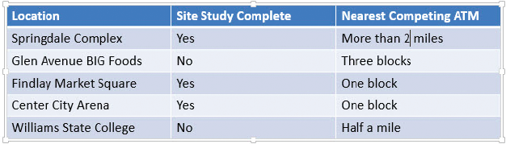
Step by Step: Insert a Table
Insert a new slide with the Title and Content layout at the end of the presentation, and click to display the new slide.
On the Insert tab, click Table to produce the Table menu and grid.

Slide 8
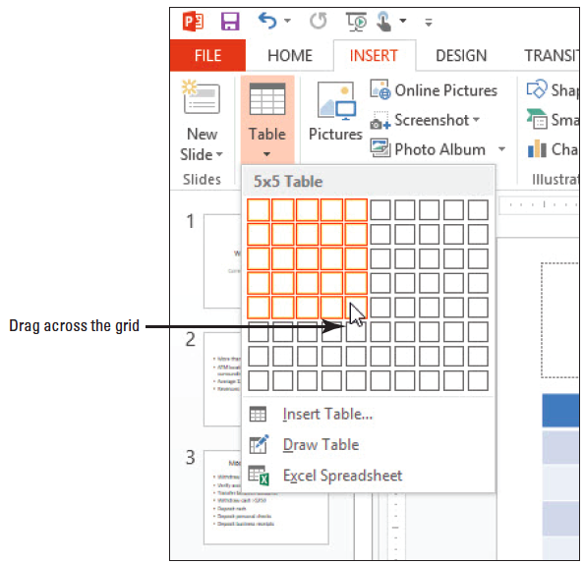
Step by Step: Insert a Table
Drag across the grid to select a 5×5 block (right), and then release the mouse button to create the table.
Delete the new slide on which you just created the table.
SAVE the presentation.
PAUSE. LEAVE the presentation open to use in the next exercise.

Slide 9
Step by Step: Draw a Table
USE the ATMs Final presentation that is still open from the previous exercise.
Insert a new slide at the end of the presentation with the Title Only layout.
On the Insert tab, click Table to open the Table menu, and then click Draw Table. The mouse pointer changes to a pencil.
Click and drag the mouse pointer to draw a frame approximately 3” high and the same width as the slide’s title placeholder box.

Slide 10
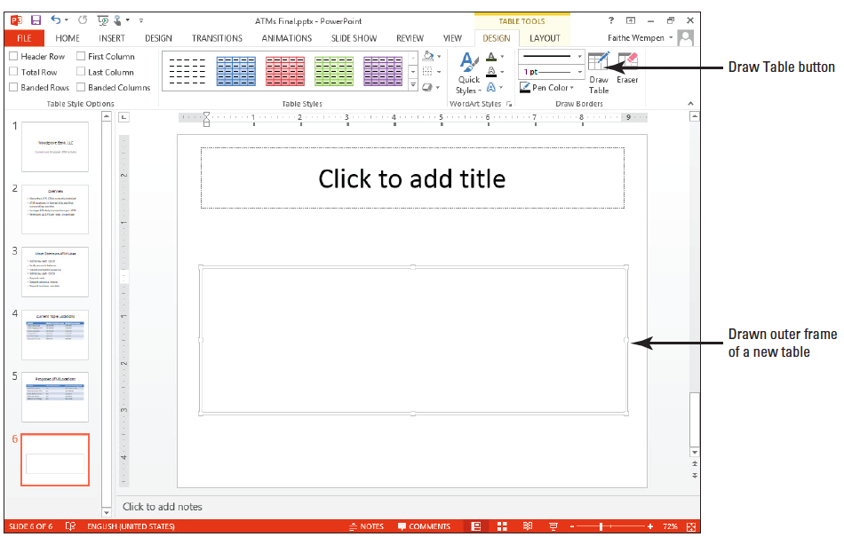
Step by Step: Draw a Table
When you release the mouse button, the new table appears (which has only one big cell), and the Table Tools Design tab is displayed (right).
On the Table Tools Design tab, click Draw Table in the Draw Borders command group. The mouse pointer becomes a pencil again.

Slide 11
Step by Step: Draw a Table
Click and drag to draw a horizontal line that divides the table horizontally. A dotted horizontal line appears. Release the mouse button to accept it.
The drawing pencil mouse pointer should stay on; if it turns itself off, click the Draw Table button again to re-enable it.
Drag a vertical line through the middle of the table to divide it vertically.
Drag another vertical line that divides only the lower-right cell of the table vertically.
Notes:
Take Note: Drag to draw the lines starting slightly inside the border rather than on the border's edge. If you start dragging too close to the border, PowerPoint creates a new table frame rather than adding to the existing table.

Slide 12

Step by Step: Draw a Table
Drag another horizontal line that divides only the lower-right cells of the table horizontally. The figure below shows the completed table.

Slide 13
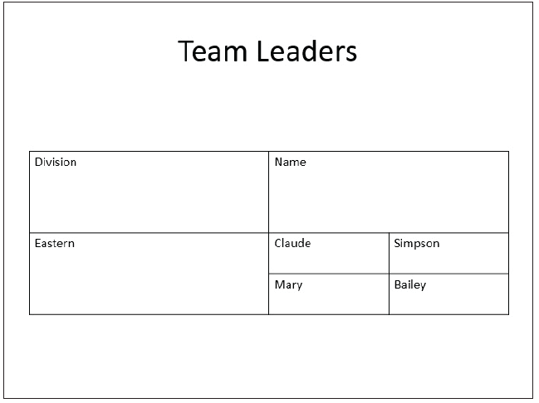
Step by Step: Draw a Table
Press Esc to turn off the pencil cursor on the mouse pointer.
Type the text shown at right into the slide’s title placeholder and into the table. You will format this table later in the lesson.
SAVE the presentation.
PAUSE. LEAVE the presentation open to use in the next exercise.

Slide 14
Step by Step: Insert an Excel Worksheet
USE the ATMs Final presentation that is still open from the previous exercise.
Insert a new slide at the end of the presentation with the Title Only layout.
Type the slide title ATM Cost Analysis.
Click away from the title text box, and then click the Insert tab, click the Table drop-down arrow, and then click Excel Spreadsheet. PowerPoint creates a small Excel worksheet on the slide. Note that the PowerPoint Ribbon has been replaced by the Excel Ribbon but the title bar still shows ATMs Final.

Slide 15
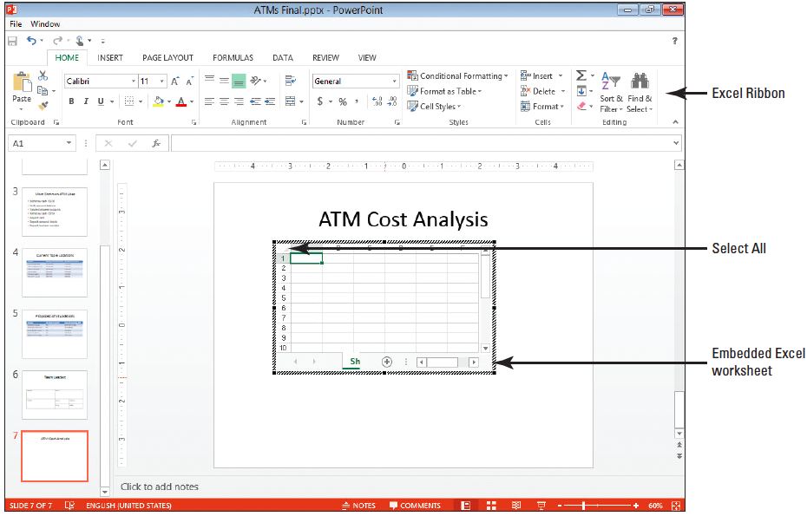
Step by Step: Insert an Excel Worksheet
Resize the worksheet object by dragging the lower-right corner handle diagonally to the right to display columns A through F and rows 1 through 10 (above).
Click the Select All area in the upper-left corner of the worksheet where the column headers and row headers intersect. The entire worksheet is selected.
Notes:
Take Note: When an Excel worksheet is open on the slide, you are actually working in Excel. To return to PowerPoint, click outside the worksheet.

Slide 16
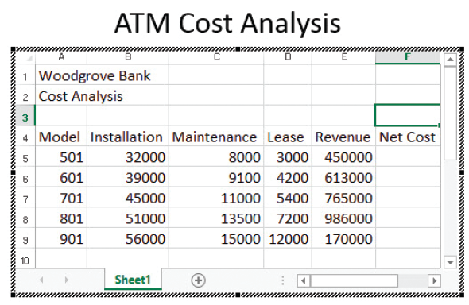
Step by Step: Insert an Excel Worksheet
Click the Font Size drop-down arrow on the Home tab and click 18.
Type data in the worksheet cells (right). To move between cells use the arrow keys on the keyboard or press Tab. To adjust column widths, position the pointer on the border between column headings so the pointer turns into a two-headed arrow and drag to the right until all data appears. The overall size of the embedded Excel spreadsheet expands as needed as you widen the columns.

Slide 17
Step by Step: Insert an Excel Worksheet
Click cell F5 and type the following formula: =E5–(B5+C5+D5). This formula sums the values in B5, C5, and D5, and then subtracts that total from the value in E5.
Press Enter to complete the formula.
Click cell F5, and then click the Copy button on the Home tab. Then click and drag over cells F6 through F9 to select them and click the Paste button to paste the formula in each of the selected cells.
Click and drag over the range B5:F9 to select those cells. Then click the Accounting Number Format button in the Number group on the Home tab to apply a currency format to the selected cells. (Do not worry if some of the cells fill up with # signs.)

Slide 18
Step by Step: Insert an Excel Worksheet
With B5:F9 still selected, click the Decrease Decimal button in the Number group twice to remove the decimal points and trailing zeros for the numbers.
Widen the columns as needed so that there are no #### entries in any of the cells.
Click cell A1 and change the font size to 24.

Slide 19
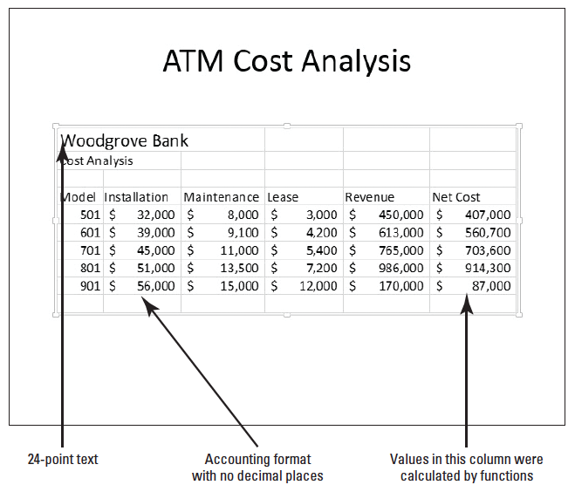
Step by Step: Insert an Excel Worksheet
Click outside the worksheet to return to PowerPoint. . Your slide should look similar to the figure below.
SAVE the presentation.
PAUSE. LEAVE PowerPoint open to use in the next exercise.
Notes:
Take Note: You know a worksheet is open and ready to edit in Excel when it displays the heavy hatched border.

Slide 20
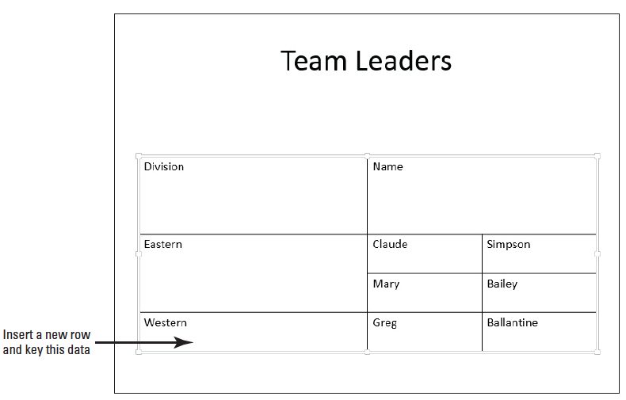
Step by Step: Add a Row and a Column
USE the ATMs Final presentation that is still open from the previous exercise.
Go to slide 6 (the Team Leaders slide).
Click at the end of the word Bailey in the last cell, and press Tab. A new row appears.
In the new row, type the data shown above.

Slide 21
Step by Step: Add a Row and a Column
Click in the cell containing Eastern and on the Table Tools Layout tab, click Insert Above in the Rows and Columns group. A new blank row appears above that cell’s row.
Drag the lower border of the first row upward, decreasing that row’s height as much as possible. (The text within that row prevents the height from being smaller than will accommodate that text.)

Slide 22
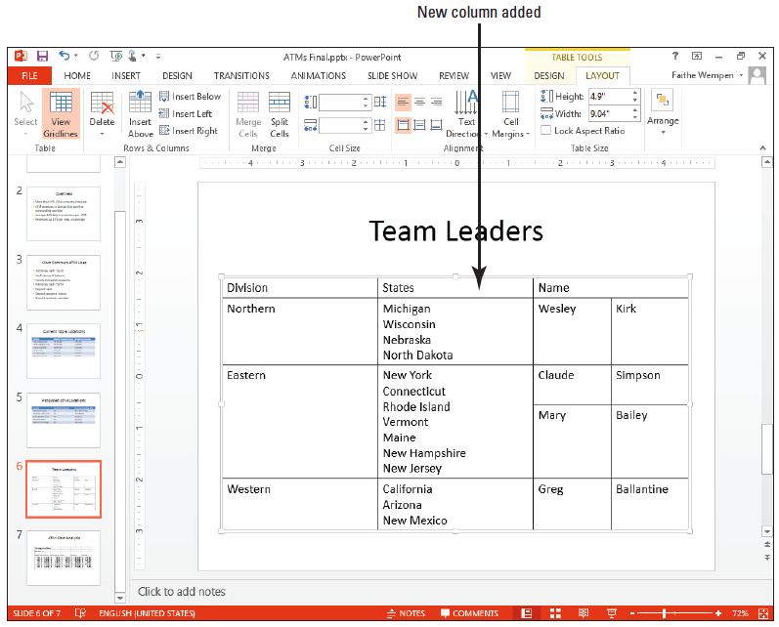
Step by Step: Add a Row and a Column
In the new column, type the data shown at right. If the table becomes so tall that it overruns the bottom of the slide, move the table upward on the slide as needed by dragging its outer border.
SAVE the presentation.
PAUSE. LEAVE the presentation open to use in the next exercise.

Slide 23
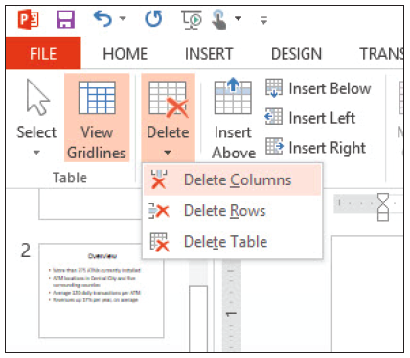
Step by Step: Delete Rows or Columns
USE the ATMs Final presentation that is still open from the previous exercise.
On slide 6, click in the upper left cell (Division).
On the Table Tools Layout tab, click the Delete button in the rows and columns group, and on the menu that appears, click Delete Columns (right). The first column is deleted.

Slide 24
Step by Step: Delete Rows or Columns
Click the Undo button on the Quick Access toolbar to undo the delete operation.
Click in the lower-left cell (Western).
On the Table Tools Layout tab, click the Delete button, and on the menu that appears, click Delete Rows. The bottom row is deleted.
Click the Undo button on the Quick Access toolbar to undo the delete operation.
SAVE the presentation.
PAUSE. LEAVE the presentation open to use in the next exercise.

Slide 25
Step by Step: Move a Column
USE the ATMs Final presentation that is still open from the previous exercise.
Go to slide 4, click in the second column, and on the Table Tools Layout tab, click Insert Left. A new column is inserted between the first and second columns.
Drag across all the cells in the rightmost column to select them.

Slide 26
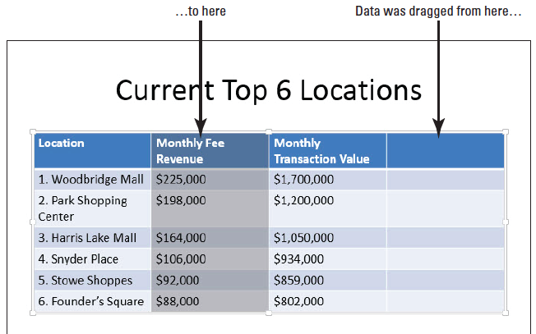
Step by Step: Move a Column
Drag the selected column and drop it on top of the first cell in the blank column you inserted in step 1. The data from the selected column is moved to the new column, and a blank column remains in the data’s previous location (right).
With the second column still selected, press Ctrl+X to cut the column’s data to the clipboard. The column disappears entirely. When you use the Ctrl+X command to cut all data from a column, a blank column is not left behind as with drag and drop.

Slide 27
Step by Step: Move a Column
Click in the first row of the empty column on the right side of the table and press Ctrl+V to paste the data into that column. The data is placed in the empty column, and the table returns to having only three columns.
Drag the table’s frame to re-center it on the slide if needed. (It may be slightly skewed to the left.)
SAVE the presentation.
PAUSE. LEAVE the presentation open to use in the next exercise.

Slide 28
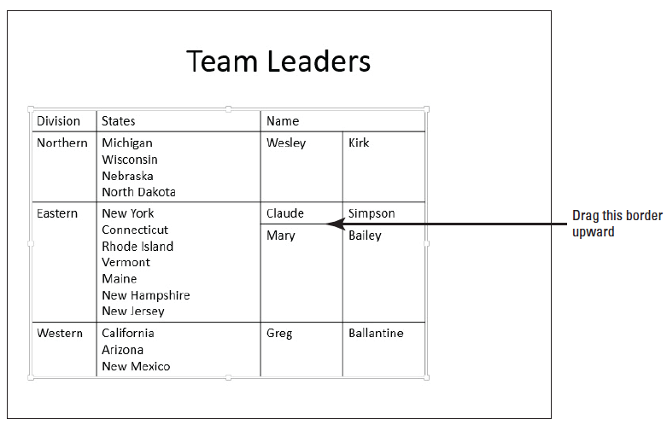
Step by Step: Resize and Distribute Rows and Columns
USE the ATMs Final presentation that is still open from the previous exercise.
Go to slide 6, and double-click the vertical border between the first and second columns.
Drag the horizontal border between the Claude Simpson and Mary Bailey lines in the table upward, so that the Claude Simpson cells are as short as possible without truncating the text (above).
Notes:
Take Note: Double-clicking a column border adjusts column width to fit the column’s widest entry.

Slide 29
Step by Step: Resize and Distribute Rows and Columns
If you need to be more precise in resizing, you can use the tools in the Cell Size group on the Table Tools Layout tab to specify exact widths and heights for table cells.
Click in the cell that contains States.
On the Table Tools Layout tab, in the Table Size group’s Width box, set the value to exactly 7” by clicking the increment arrows or typing over the existing value.

Slide 30
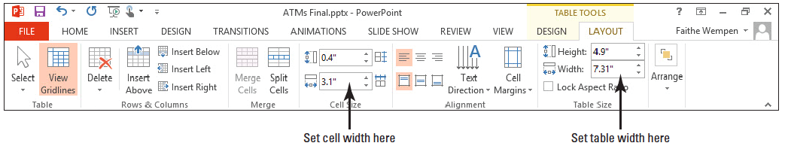
Step by Step: Resize and Distribute Rows and Columns
In the Cell Size group’s Width box, set the value to exactly 3” by clicking the up increment arrow or by typing over the existing value (below).
Drag the outer border of the table to the right as needed to re-center the table beneath the Team Leaders title.
Select the entire table by dragging across it.
Notes:
Take Note: The Width setting in the Table Size group controls the width of the entire table; the Width setting in the Cell Size group controls the width of only the column in which the active cell is located. The active cell is the one containing the insertion point.

Slide 31

Step by Step: Resize and Distribute Rows and Columns
On the Table Tools Layout tab, click the Distribute Columns button. Each column becomes the same width.
SAVE the presentation.
PAUSE. LEAVE the presentation open to use in the next exercise.

Slide 32
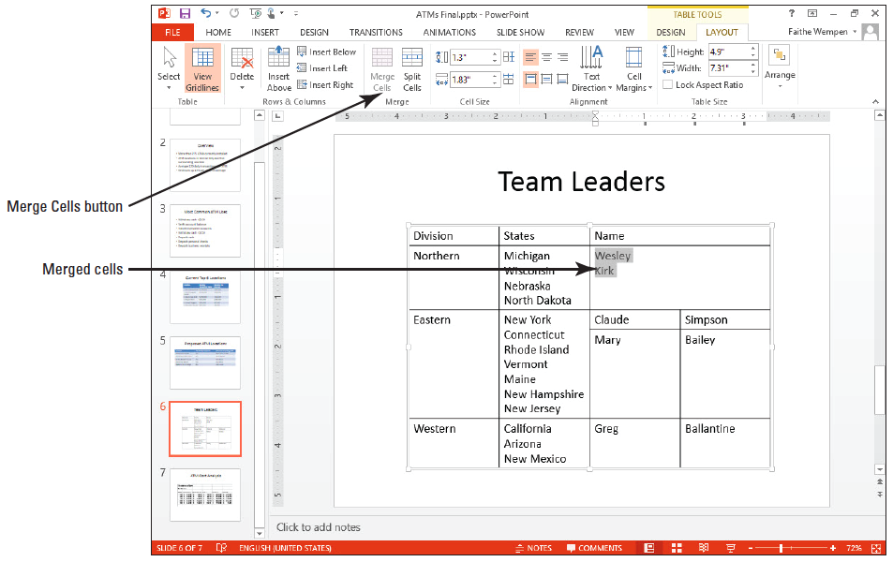
Step by Step: Merge and Split Table Cells
USE the ATMs Final presentation that is still open from the previous exercise.
Go to slide 6 and select the cells containing Wesley and Kirk.
On the Table Tools Layout tab, click Merge Cells. The two cells become one, and the text from both cells appears in the merged cell separated by a paragraph break (above).

Slide 33
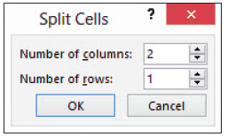
Step by Step: Merge and Split Table Cells
Select all three cells that contain state names, and on the Table Tools Layout tab, click Split Cells. The Split Cells dialog box opens (right).
In the Number of Columns text box, type 2 to set the number of columns to 2 if it is not already at that value. In the Number of Rows box, type 1 to set the number of rows to 1 if it is not already at that value. Then click OK. Select the entire table, and then click the Distribute Columns button on the Table Tools Layout tab to equalize the column widths.

Slide 34
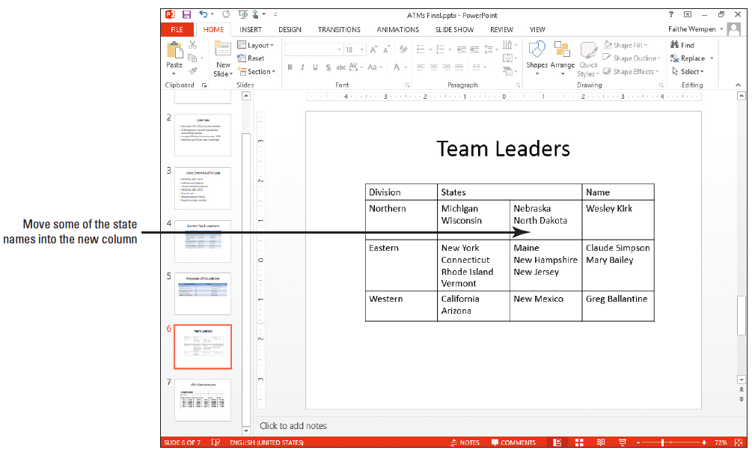
Step by Step: Merge and Split Table Cells
For each division, move approximately half of the names from the existing cell to the empty cell to it s right (right). You can move the text either with drag and drop or cut and paste.
SAVE the presentation file and CLOSE it.
PAUSE. LEAVE PowerPoint open to use in the next exercise.

Slide 35
Step by Step: Align and Orient Text in a Table
GET READY. To align and orient text in a table, do the following:
OPEN the Bids presentation and save it as Final Bids.
Go to slide 2, and click in the merged cell at the far left of the table.
Click the Table Tools Layout tab, and then click the Text Direction button to display a menu of orientation options.

Slide 36
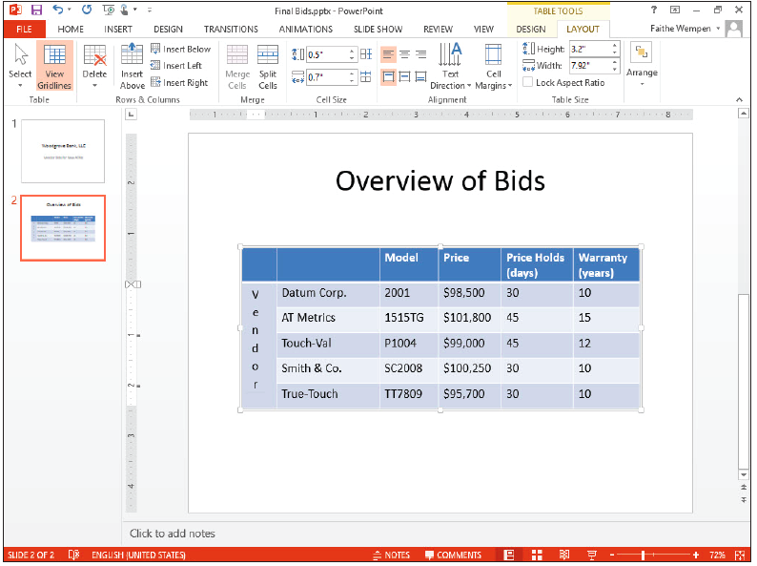
Step by Step: Align and Orient Text in a Table
Click Stacked. This option will stack text with each letter below the previous one.
Type Vendor in the merged cell. The text stacks in the merged cell (right).

Slide 37
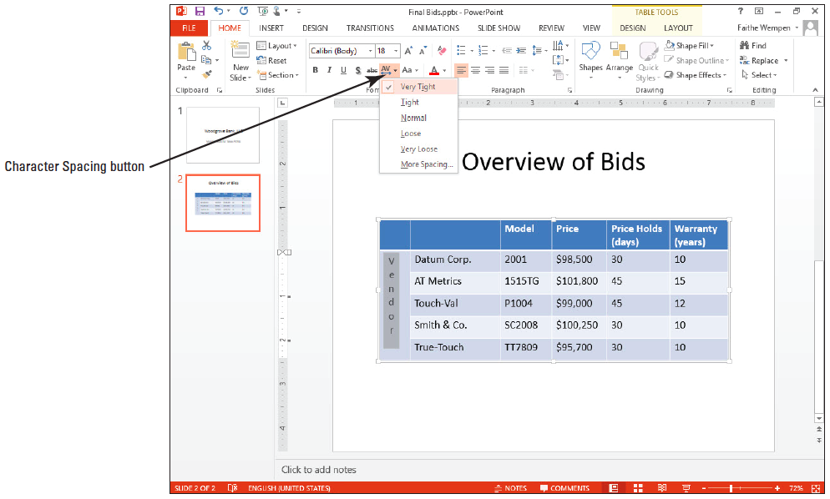
Step by Step: Align and Orient Text in a Table
Select the text you just typed. Click the Home tab, and then click the Character Spacing button in the Font group. Click Very Tight (right).
With text still selected, click the Bold button in the Font group on the Home tab.
Notes:
Take Note: When you move the I-beam pointer over rotated or stacked text, its orientation changes to match the text orientation.

Slide 38


Step by Step: Align and Orient Text in a Table
Select the cells with numbers in the Price column. Click the Align Text Right button in the Paragraph group to align all text in that column along the right side of the cells.
Select the cells with numbers in the last two columns. Click the Center button to center the contents of those cells.
Select the cells in the column header row. Beca use they are already blue, it will not be obvious that they are selected.

Slide 39
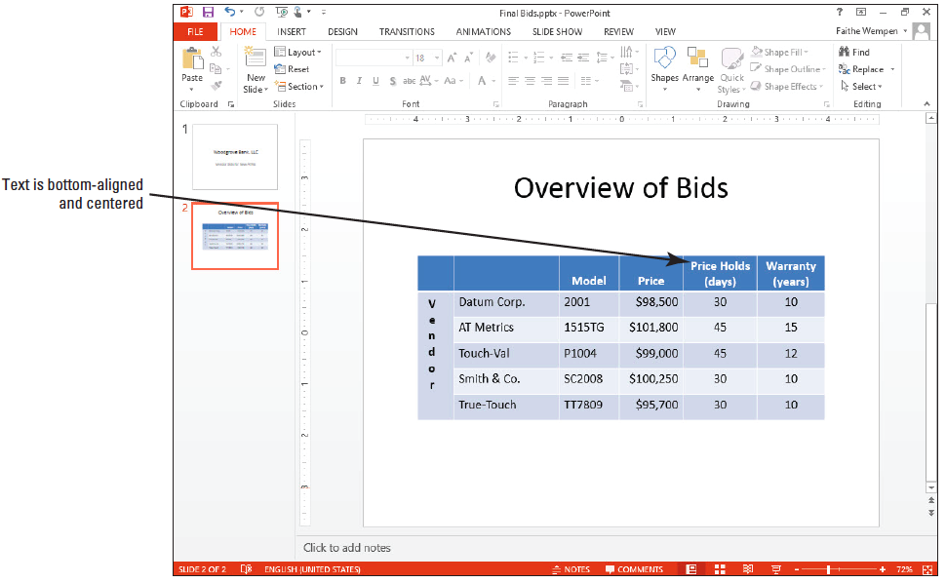

Step by Step: Align and Orient Text in a Table
Click the Center button on the Home tab to center the contents of those cells.
Click the Table Tools Layout tab, and click the Align Bottom button in the Alignment group. All column headings now align at the bottom of the cells (above).
SAVE the presentation.
PAUSE. LEAVE the presentation open to use in the next exercise.

Slide 40
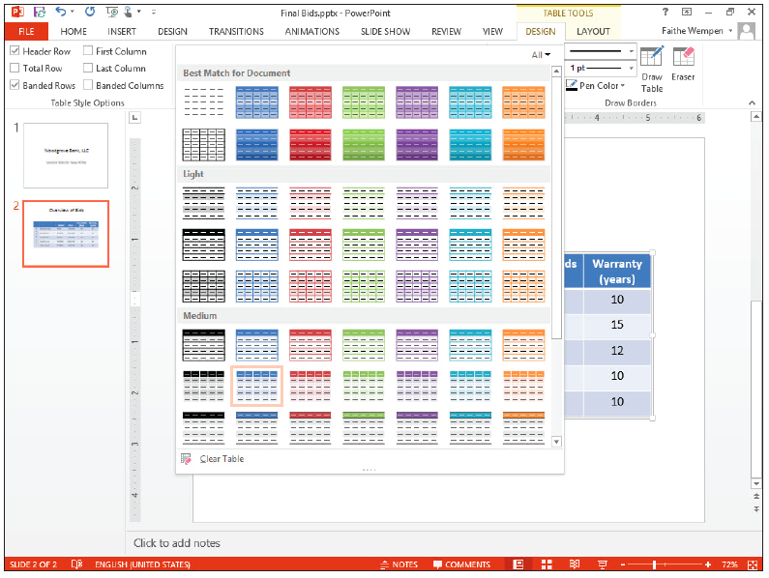
Step by Step: Apply a Table Style
USE the Final Bids presentation that is still open from the previous exercise.
Click anywhere in the table on slide 2, and then click the Table Tools Design tab.
Click the More button in the Table Styles group to display the Table Styles gallery (right). Note that the table styles are organized into several groups—Best Match for Document, Light, Medium, and Dark.

Slide 41
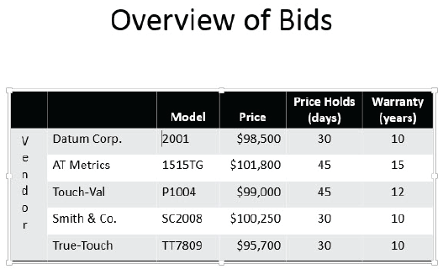
Step by Step: Apply a Table Style
Click the Themed Style 2 – Accent 6 table style. This style is a colorful alternative, but not exactly what you want.
Click the More button again, and then click the Medium Style 3 style, a black and gray com- bination in the first column of the gallery. Your table should look similar to the figure at right.
PAUSE. LEAVE the presentation open.

Slide 42
Step by Step: Turn Table Style Options On and Off
USE the Final Bids presentation that is still open from the previous exercise.
Click anywhere in the table to select it if necessary.
Click the Table Tools Design tab if it is not already displayed.
Click the Banded Rows option in the Table Style Options group to deselect the option.

Slide 43
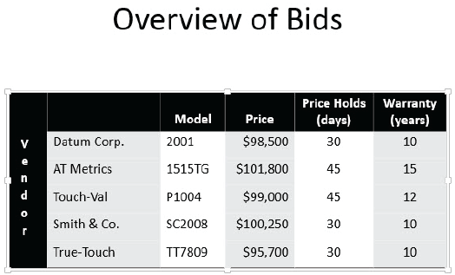
Step by Step: Turn Table Style Options On and Off
Click the First Column option. The first column receives special emphasis.
Click the Banded Columns option. Color bands are applied to the columns. Your table should look similar to the figure at right.
SAVE and close the presentation.
PAUSE. LEAVE PowerPoint open to use in the next exercise.

Slide 44
Step by Step: Add Shading to Cells
GET READY. To add shading to cells, perform the following steps:
OPEN the Warranties presentation and save it as Warranties Final.
Go to slide 2, and select the cells in the top row (the column header row).
Click the Table Tools Design tab, and then click the Shading button drop-down arrow in the Table Styles group. The Shading color palette displays.

Slide 45
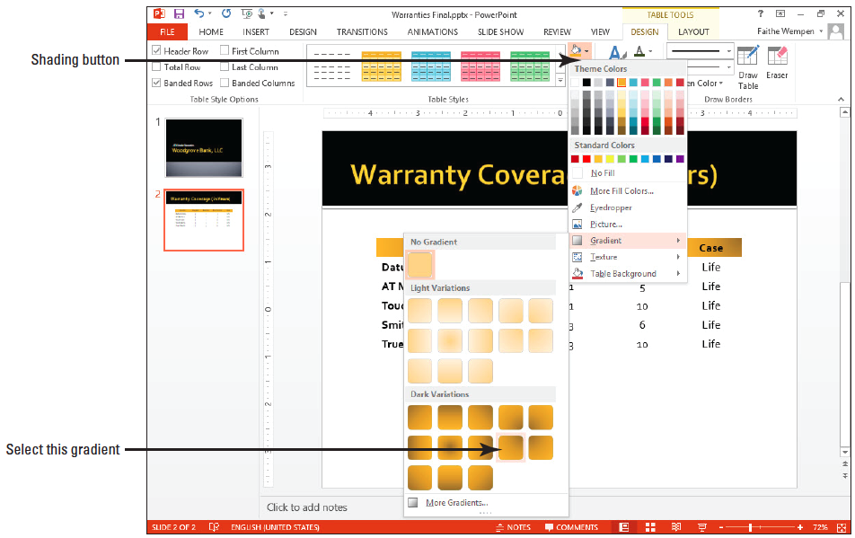
Step by Step: Add Shading to Cells
Click the Gold, Accent 1 color to fill the column header cells with gold.
With the column header cells still selected, click the Shading drop- down arrow again, point to Gradient, and select the From Top Right Corner gradient style in the Dark Variations section of the gallery (right).
SAVE the presentation.
PAUSE. LEAVE the presentation open to use in the next exercise.

Slide 46
Step by Step: Add Borders to Table Cells
USE the Warranties Final presentation that is still open from the previous exercise.
In the table on slide 2, select all cells except those in the first column and the column header cells. (You are selecting the numbers and the Life entries.)
On the Table Tools Design tab, click the Border drop-down arrow in the Table Styles group. A menu of border options appears.

Slide 47
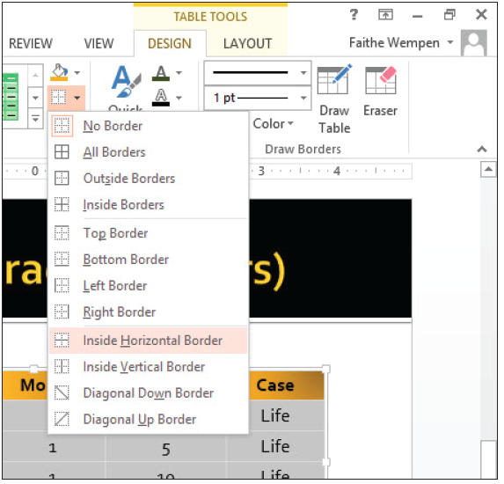
Step by Step: Add Borders to Table Cells
Click Inside Horizontal Border (right).
Click outside the table to deselect the cells, and then select only the bottom row of the table.
Click the Border drop- down arrow, and then click Bottom Border. A border is applied to the entire bottom row of the table.

Slide 48
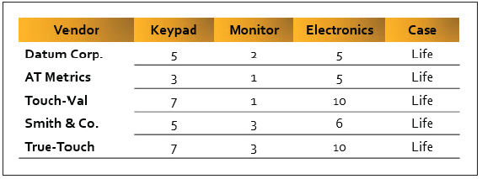
Step by Step: Add Borders to Table Cells
Click outside the table to deselect the cells. Your table should look like the figure at right.
SAVE the presentation.
PAUSE. LEAVE the presentation open to use in the next exercise.
Notes:
Take Note: The Shading button also shows the latest shading color you chose making it easy to apply the same color again.
Take Note: To insert two values in a cell, set left alignment and type the first value, then press Ctrl+Tab or use the spacebar to move to the other half of the cell to type the second value.

Slide 49
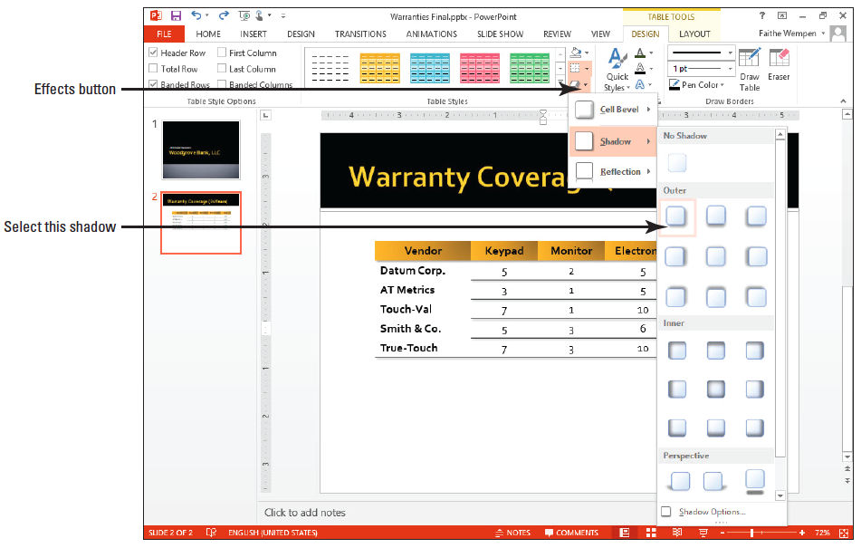
Step by Step: Add Special Effects to a Table
USE the Warranties Final presentation that is still open from the previous exercise.
Click anywhere in the table on slide 2.
Click the Effects button in the Table Styles group (Table Tools Design tab), point to Shadow, and click Offset Diagonal Bottom Right in the Outer section (above).

Slide 50
Step by Step: Add Special Effects to a Table
Click outside the table to see the effect.
SAVE the presentation.
PAUSE. LEAVE the presentation open to use in the next exercise.

Slide 51
Adding an Image to a Table
An image can serve as the background in one or more table cells.
The image is not the cell content, but rather a background fill, just as a color fill would be.
The text in the cell appears on top of the background fill.

Slide 52
Step by Step: Add an Image to a Table
USE the Warranties Final presentation that is still open from the previous exercise.
In the table on slide 2, select the vendor names in the first column of the table. (Do not select the Vendor column heading.)
Right-click in one of the selected cells, then click Format Shape on the menu that appears. The Format Shape task pane displays.
In the task pane, click Fill to expand that category if it is not already expanded.

Slide 53
Step by Step: Add an Image to a Table
Click Picture or texture fill.
Click the File button and in the Insert Picture dialog box, navigate to the location of your data files. Select ATM.jpg and click Insert.
In the Format Shape task pane, click to place a checkmark in the Tile picture as texture check box.

Slide 54
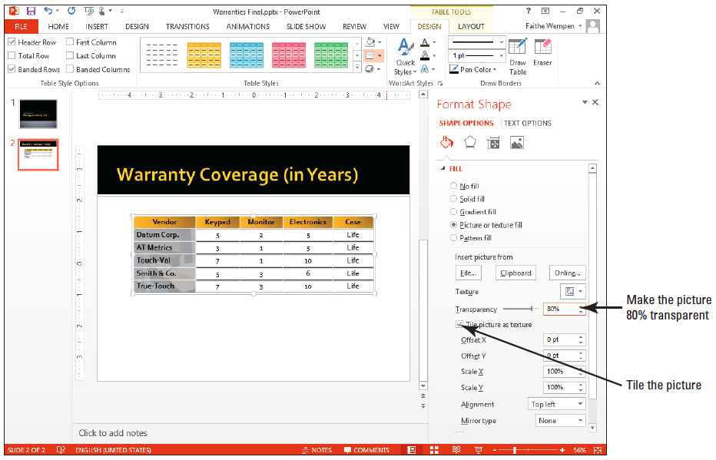
Step by Step: Add an Image to a Table
Drag the Transparency slider until the box to the right of the slider reads 80% or type 80 in the Transparency box (below).
Close the task pane. Click outside the table. The selected cells have a semi- transparent fill using the selected graphic.
SAVE the presentation.
PAUSE. LEAVE the presentation open to use in the next exercise.

Slide 55
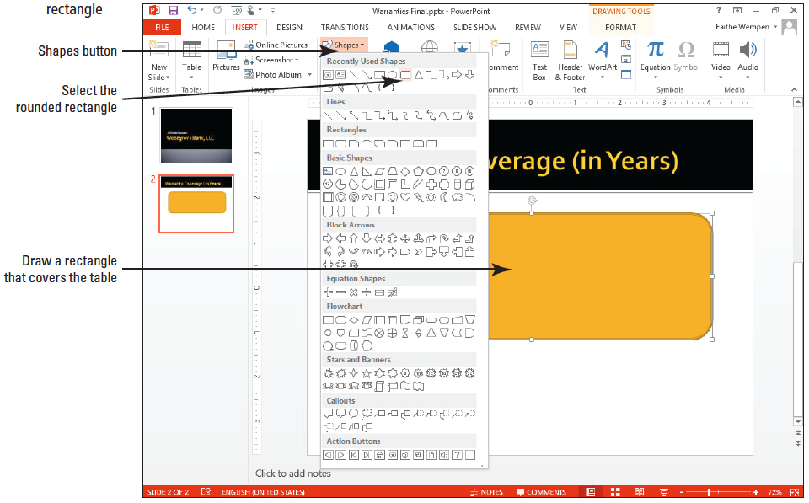
Step by Step: Arrange a Shape and a Table
USE the Warranties Final presentation that is still open from the previous exercise.
Display slide 2 and on the Insert tab, click the Shapes button to open the Shapes gallery. Then click the rounded rectangle in the first row of shapes.
Drag to draw a rounded rectangle that completely covers the table (above).

Slide 56
Step by Step: Arrange a Shape and a Table
On the Drawing Tools Format tab, click Send Backward in the Arrange command group. The shape is sent behind the table.
With the shape still selected, click the Shape Fill button in the Shape Styles group and click More Fill Colors from the menu that appears. The Colors dialog box opens.

Slide 57
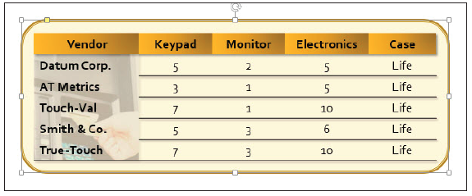
Step by Step: Arrange a Shape and a Table
Drag the Transparency slider to 85%, and then click OK. The rectangle appears as a lightly shaded background behind the table (below).
SAVE and CLOSE the presentation.
EXIT PowerPoint.

Slide 58
Skill Summary

